Slide 1
Class #9
Epi in the news
Lecture
In class exercises
TO DO:
Optional reading on effect measure modification (Gordis)
PSET 7

Slide 2
Learning objectives
Understand the importance of confounding to the interpretation of epidemiological studies
Be able to define and provide examples of confounding
Know and understand the properties of a confounder
Know several different methods to control confounding in a study
Be able to critically analyze the potential for an association to be due to confounding

Slide 3
Why is confounding such an important topic in epidemiology?
Main goal of epidemiology is to estimate the effect of an exposure on an outcome to infer causality
We can wrongfully attribute the cause of a health outcome
Causal?
Cell phones
Brain cancer
Causal?
Maternal folic acid
Childhood cancer
Causal?
Public Education
Low test scores

Slide 4


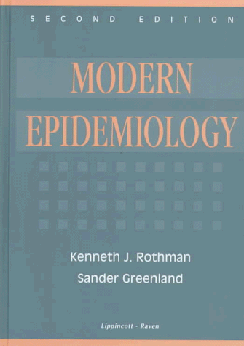
What is confounding? A third variable problem
Confounding can be thought of as a confusion of effects. The apparent effect of the exposure of interest is distorted because the effect of an extraneous third factor is mistaken for or mixed with the actual effect Rothman and Greenland (1998)

Slide 5
What is confounding?
The causal relation between exposure and disease is distorted due to:
Association of the exposure with other factors that influence the outcome
An extraneous variable that explains, totally or in part, an observed association between an exposure and a disease, or one that masks a true (i.e., causal) association.

Slide 6
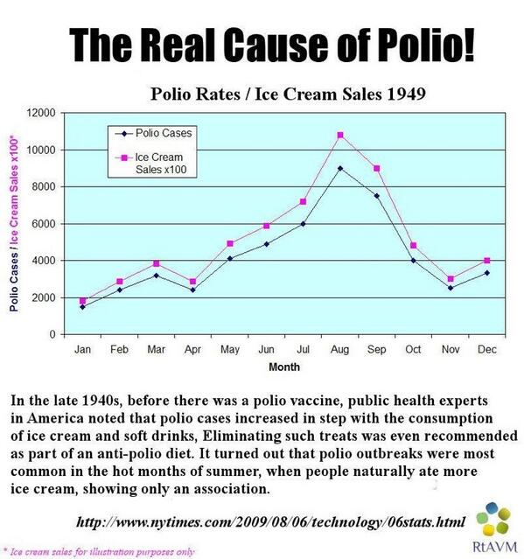
What do you think the confounder is here?

Slide 7
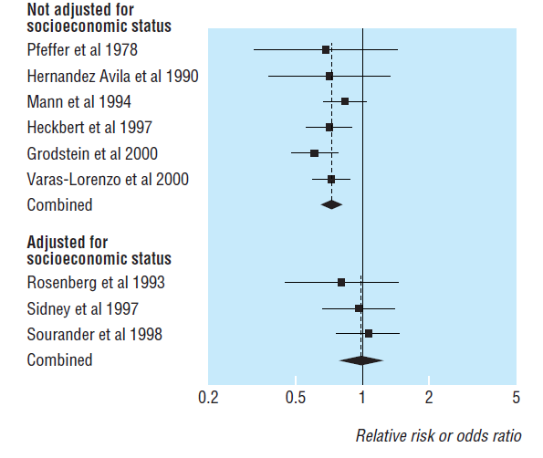
Example Hormone replacement therapy and coronary heart disease (observational studies)
Meta analysis of observational studies hormone replacement therapy and coronary heart disease (Humphrey et al, 2002)
-
HRT
CHD
+
-
High SES

Slide 8
Class check in Are you with me so far?
A. Yes
B. No
https://b.socrative.com/teacher/#live-results/question/1

Slide 9
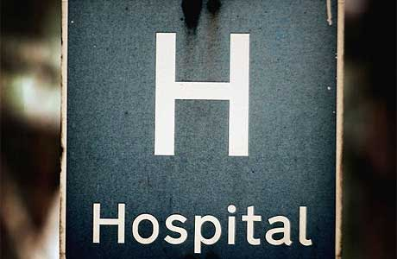

In class exercise Is alcohol a risk factor for lung cancer?
You do a small case control study to answer this question
You include 20 cases with lung cancer and 20 controls sampled from a local hospital
You administer a survey
10 cases and 5 controls report drinking alcohol
Causal?
Alcohol
Lung cancer

Slide 10
Case-control study of lung cancer and alcohol
Cases |  |  |  |  | Controls
☹ | ☹ | ☹ | ☹ | ☹ | ☺ | ☺ | ☺ | ☺ | ☺
☹ | ☹ | ☹ | ☹ | ☹ | ☺ | ☺ | ☺ | ☺ | ☺
☹ | ☹ | ☹ | ☹ | ☹ | ☺ | ☺ | ☺ | ☺ | ☺
☹ | ☹ | ☹ | ☹ | ☹ | ☺ | ☺ | ☺ | ☺ | ☺
 | Cases | Controls
Alcohol drinkers | 10 | 5
Non-drinkers | 10 | 15
Blue=drinkers
Black=non-drinkers
OR=(a*d)/(b*c)=

Slide 11
Calculate the relationship between alcohol and lung cancer separately for smokers and nonsmokers
Smokers
Non-Smokers
Cases |  |  |  |  | Controls
☹ | ☹ | ☹ | ☹ | ☹ | ☺ | ☺ | ☺
☹ | ☹ | ☹ | ☹ | ☹ | ☺
☹ | ☹
Cases |  |  |  |  | Controls
☹ |  |  |  |  | ☺ | ☺
☹ | ☹ | ☹ | ☹ | ☹ | ☺ | ☺ | ☺ | ☺ | ☺
☹ | ☹ |  |  |  | ☺ | ☺ | ☺ | ☺ | ☺
 |  |  |  |  | ☺ | ☺ | ☺ | ☺
 | Cases | Controls
Alcohol drinkers | 1 | 2
Non-drinkers | 7 | 14
 | Cases | Controls
Alcohol drinkers | 9 | 3
Non-drinkers | 3 | 1
OR_{smokers}=
OR_{non-smokers}=

Slide 12
Confounding diagram
Exposure (Alcohol)
Outcome (Lung cancer)
Third variable (smoking)
Conclusion:
Because the stratified measures of association were similar to one another (both 1.0) but different from the crude measure (3.0), we can say that the crude estimated was confounded by smoking.

Slide 13
Class check in Are you with me so far?
A. Yes
B. No
https://b.socrative.com/teacher/#live-results/question/1

Slide 14
Criteria of a Confounder
Must be an independent risk factor for disease
i.e. a risk factor for the disease among those not exposed to the factor of interests
Must be associated with the exposure of interest (in controls in a case-control study or in the source population)
i.e. unequally distributed between exposed and unexposed
Cannot be an intermediate step in the causal pathway between exposure and disease
i.e. exposure cannot be a cause of the confounder
EXPOSURE → Factor A → DISEASE

Slide 15
Let’s see how this works in the alcohol and lung cancer example

Slide 16
Alcohol and lung cancer example
Must be a risk factor for disease among those who are not exposed to the factor of interest
Is smoking an independent risk factor for lung cancer?
 |  | Cases | Controls
Smokers | Alcohol drinkers | 9 | 3
 | Non-drinkers | 3 | 1
Non-smokers | Alcohol drinkers | 1 | 2
 | Non-drinkers | 7 | 14
Non-drinkers
 | Cases | Controls
Smokers | 3 | 1
Non-smoker | 7 | 14
Total | 10 | 15
OR=(a*d)/(b*c)=
(3*14)/(7*1)=6.0
Interpretation: Among non-drinkers, cases were 6 times more likely to be smokers than controls

Slide 17
Alcohol and lung cancer example
2. Must be associated with the exposure of interest (in the source population or controls in a case-control study)
Is drinking associated with smoking?
Controls
 |  | Cases | Controls
Smokers | Alcohol drinkers | 9 | 3
 | Non-drinkers | 3 | 1
Non-smokers | Alcohol drinkers | 1 | 2
 | Non-drinkers | 7 | 14
 | Smokers | Non-smokers
Alcohol drinkers | 3 | 2
Non-drinkers | 1 | 14
total | 4 | 16
OR=(a*d)/(b*c)=(3*14)/(2*1)=21!
Interpretation: Among controls, smokers were 21 times more likely to be drinkers than nonsmokers

Slide 18
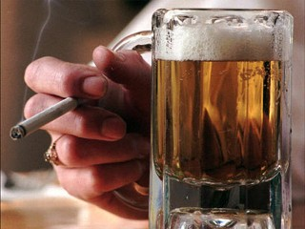
Alcohol and lung cancer example
3. Cannot be an intermediate step in the causal pathway between exposure and disease (biological property)
EXPOSURE → Factor A → DISEASE
Drinking→ smoking→ lung cancer?
Drinking alcohol does not necessarily cause one to become a smoker!

Slide 19
The relationship between alcohol and lung cancer was confounded by smoking
+
Alcohol
Lung cancer
+
+
smoking
Smoking fulfills the 3 properties of a confounder
Smoking is a risk factor for lung cancer in non-drinkers
Smoking is associated with drinking in controls
Smoking is not in the causal pathway between alcohol and lung cancer

Slide 20
Down syndrome by birth order

Slide 21
Confounding or not?
High birth order
Down syndrome
Advanced Maternal age

Slide 22
Down syndrome by maternal age

Slide 23
Down syndrome by birth order and maternal age groups

Slide 24
Confounding or not?
Lighter in pocket
CHD
Smoking

Slide 25
Confounding or not?
Lighter in pocket
CHD
Smoking
Smoking is associated with a lighter in pocket and is an independent cause of CHD. Therefore smoking is a confounder of the association between lighter in pocket and CHD

Slide 26
Confounding or not?
Smoking
CHD
Lighter in pocket
https://b.socrative.com/teacher/#live-results/question/1

Slide 27
Confounding or not?
Smoking
CHD
Lighter in pocket
Lighter in pocket is associated with smoking but it is not an independent cause of CHD. Therefore lighter in pocket is not a confounder of the association between smoking and CHD

Slide 28
Confounding or not?
Maternal smoking
Infant mortality
Low birth weight

Slide 29
Confounding or not?
Maternal smoking
Infant mortality
Low birth weight
Maternal smoking is a cause of low birth weight which is a cause of infant mortality. Therefore low birth weight is an intermediate variable in the causal pathway and not a cofounder.

Slide 30
Evaluation of potential confounders of an exposure disease relationship
Literature search for factors associated with the outcome and the exposure before study begins
Statistical evaluation after data has been collected
10% rule of thumb (if the confounder adjusted measure of association differs from the crude measure of association by more than 10%, we can say the crude measure of association is confounded and talk about direction of bias)

Slide 31
How do we control for confounding?
Design stage
Randomization-RCTs
Restriction
Matching
Analysis stage
Stratification
Standardization (covered last week)
Pooling
Multivariable modeling (covered in 2nd epi class and ALM)

Slide 32
Design stage: randomization
The process of randomization distributes both known and unknown confounders between the intervention and control groups
Most effective with large sample sizes
Not really possible except in randomized controlled trials
Not ethical for some exposures
Coffee
CHD
Smoking
There is no association between coffee drinking and smoking because smokers are balanced between coffee drinking and non-coffee drinking arms of the trial through the process of randomization.

Slide 33
Design stage: Restriction
Restriction limits the eligibility criteria to exclude people with potential confounders
Age
Gender
Socioeconomic status
Smoking
Advantages: simple to implement, cost effective
Disadvantages: limits generalizability of finding, residual confounding may exist if restriction categories are too wide (e.g. 50-59 years of age)

Slide 34
Design stage: Matching
Most commonly used in case-control studies
Select study participants so confounders are evenly distributed between cases and controls
Frequency matching-Ensures comparable distribution of matching factor between exposed and unexposed groups (cohort study) or cases and controls (case-control study)
Individual matching
Subjects are matched one to one on a confounder
Advantages: direct control of confounders, sufficient number of controls in analysis
Disadvantages: requires special analysis techniques, overmatching, cannot evaluate the association between the matched variable and the outcome, exclusion of cases without controls

Slide 35
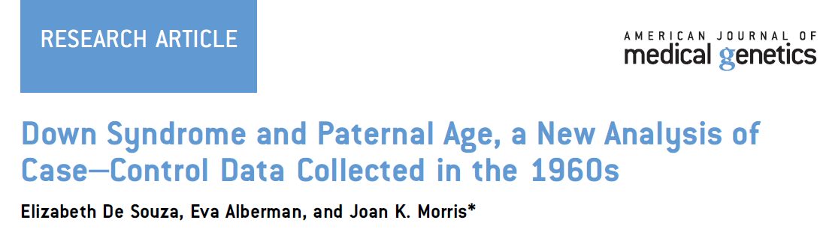
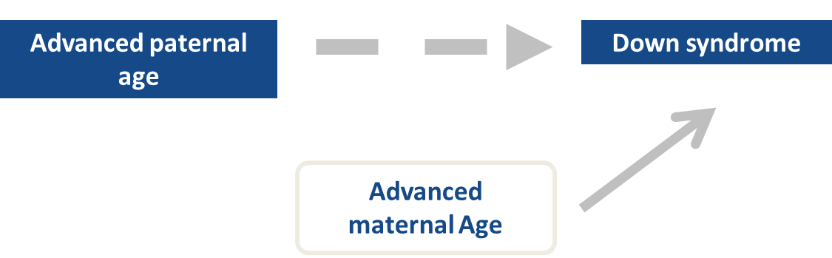
Study conducted in UK
Data originally collected to study paternal radiation exposure and Down Syndrome
Investigators wanted to know whether paternal age increases the risk of DS independently of maternal age
Matched DS cases to controls individually on maternal age within 6 months
OR_{10 year increase paternal age}=
1.13 (95% CI 0.85-1.95)

Slide 36
Is advanced maternal age a confounder of the association between paternal age and Down syndrome?
A. Yes
B. No
https://b.socrative.com/teacher/#live-results/question/1

Slide 37
Analysis stage: Stratification
Used to examine whether the exposure disease relationship is confounded by a third variable
Study subjects are split into strata based on the level of the confounder
Exposure disease relationship is then measured separately for each strata
Stratum specific measures of association are compared to each other and then if they are similar but different from the crude-confounding is present
Advantages
Minimum assumptions
Straightforward computation
Disadvantages
Small numbers in some strata make estimates less stable
Various ways to form strata
Difficult interpretation with several confounders

Slide 38
Steps in conducting a stratified analysis
Calculate crude measure of association (OR, CIR, IRR)-if not already given
Stratify data on level of potential confounder and calculate stratum-specific measures of association
Compare stratum specific measures of association to each other (CIR, IRR, OR)
If stratum specific measures of association are similar to each other but different from the crude measure of association, confounding is present

Slide 39
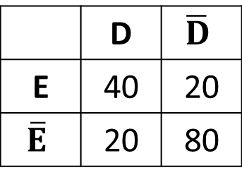
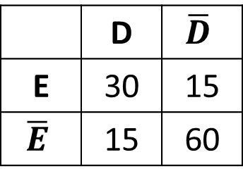
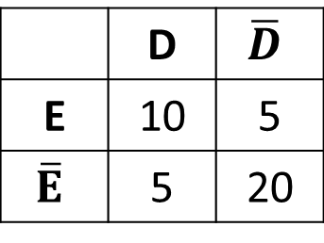
Stratification
Scenario 1: No Confounding
Stratum 1 (Young)
Crude (not stratified)
Stratum 2 (Old)
 | D | $$\overline{D}$$
E | 40 | 20
$$\overline{E}$$ | 20 | 80
 | D | $$\overline{D}$$
E | 10 | 5
$$\overline{E}$$ | 5 | 20
 | D | $$\overline{D}$$
E | 30 | 15
$$\overline{E}$$ | 15 | 60
OR_{(crude)} = 8.0
OR₍₁₎ = 8.0
OR₍₂₎ =8.0

Slide 40
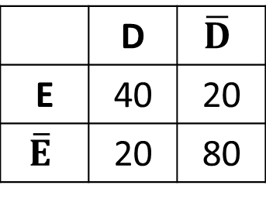
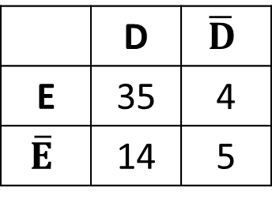
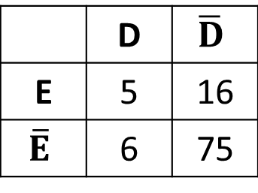
Stratification
Scenario 2: Confounding
Stratum 1 (Young)
Crude (not stratified)
Stratum 2 (Old)
 | D | $$\overline{D}$$
E | 40 | 20
$$\overline{E}$$ | 20 | 80
 | D | $$\overline{D}$$
E | 5 | 16
$$\overline{E}$$ | 6 | 75
 | D | $$\overline{D}$$
E | 35 | 4
$$\overline{E}$$ | 14 | 5
OR_{(crude)} =8.0
OR₍₁₎ =3.91
OR₍₂₎ =3.13

Slide 41
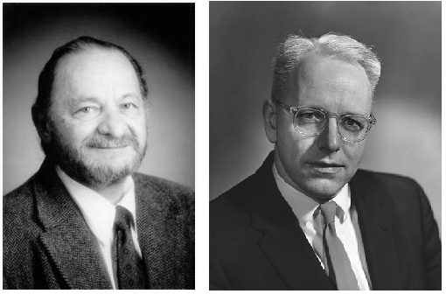
Mantel-Haenszel Summary Estimate (covered in the Appendix of the class book)
A weighted average of the stratum-specific measures of association
Advantages
Yields a single adjusted summary estimate for an exposure disease relationship
Disadvantages
Assumes same effect across strata
Weight scheme across strata is buried in the M-H formula
Results harder to compare to other studies that use different ways to categorize confounder

Slide 42
∑a_{i}d_{i}/T_{i}
Case-control study
OR_{M-H}=
∑b_{i}c_{i}/T_{i}
CIR_{M-H}=
∑a_{i}(c_{i}+d_{i})/T_{i}
Cohort study
∑c_{i}(a_{i}+b_{i})/T_{i}
Cohort or experimental
study with
person-time in denominator
∑a_{i}(PT_{Oi})/PT_{i}
IRR_{M-H}=
∑c_{i}(PT_{Ii})/PT_{i}
i is the symbol used to designate the stratum number
If you have 2 strata, i will take the numbers of 1 and 2
I, O are notations used to indicate exposed and unexposed
Σ means to sum across strata

Slide 43
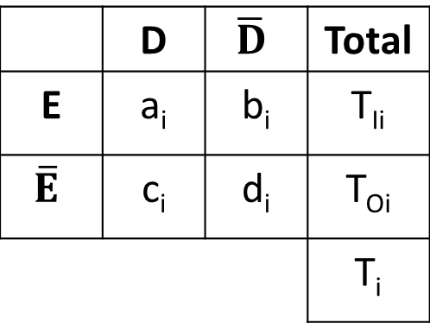
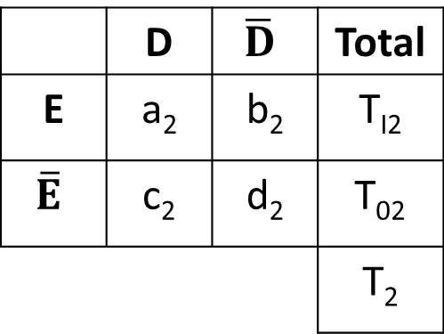
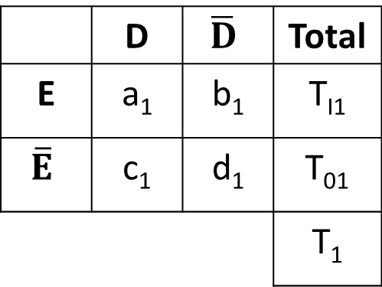
Layout for the i^{th} stratum and strata 1 and 2 with cumulative incidence (cohort) data
 | D | $$\overline{D}$$ | Total
E | a_{i} | b_{i} | T_{Ii}
$$\overline{E}$$ | c_{i} | d_{i} | T_{Oi}
 |  |  | T_{i}
∑a_{i}(c_{i}+d_{i})/T_{i}
CIR_{M-H}=
∑c_{i}(a_{i}+b_{i})/T_{i}
Stratum 1
Stratum 2
 | D | $$\overline{D}$$ | Total
E | a₁ | b₁ | T_{I1}
$$\overline{E}$$ | c₁ | d₁ | T₀₁
 |  |  | T₁
 | D | $$\overline{D}$$ | Total
E | a₂ | b₂ | T_{I2}
$$\overline{E}$$ | c₂ | d₂ | T₀₂
 |  |  | T₂
[a₁(c₁+d₁)/T₁] + [a₂(c₂+d₂)/T₂]
[c₁(a₁+b₁)/T₁] + [c₂(a₂+b₂)/T₂]

Slide 44
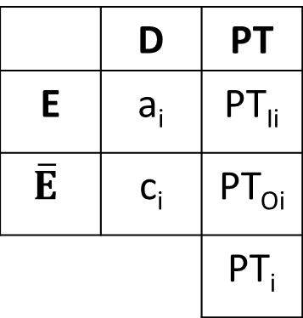
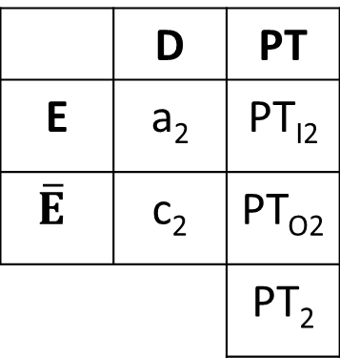
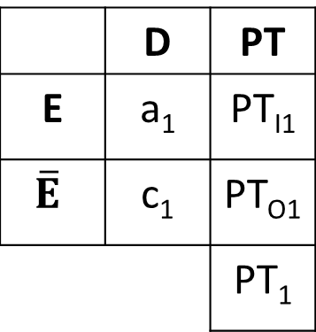
Layout for the i^{th} stratum and strata 1-2 with incidence rate (cohort) data
 | D | PT
E | a_{i} | PT_{Ii}
$$\overline{E}$$ | c_{i} | PT_{Oi}
 |  | PT_{i}
∑a_{i}(PT_{Oi})/PT_{i}
IRR_{M-H}=
∑c_{i}(PT_{Ii})/PT_{i}
Stratum 1
Stratum 2
 | D | PT
E | a₁ | PT_{I1}
$$\overline{E}$$ | c₁ | PT_{O1}
 |  | PT₁
 | D | PT
E | a₂ | PT_{I2}
$$\overline{E}$$ | c₂ | PT_{O2}
 |  | PT₂
[a₁(PT_{O1})/PT₁] + [a₂(PT_{O2})/PT₂]
[c₁(PT_{I1})/PT₁] + [c₂(PT_{I2})/PT₂]

Slide 45
Example - Incidence Rate Data
Exposure = Male sex (females are unexposed)
Outcome = Trigeminal Neuralgia-Related death
Potential confounder = Age (< 65; 65+)
Person-
Years
Deaths
Males
90
2465
Females
131
3946
Crude IRR (males vs. females)=

Slide 46
The intense flashes of pain can be triggered by vibration or contact with the cheek (such as when shaving, washing the face, or applying makeup), brushing teeth, eating, drinking, talking, or being exposed to the wind. People with TN avoid social contact and daily activities such as eating and talking because they fear an attack. Many have been known to lose their jobs because of the debilitating nature of the pain. Marriages have dissolved due to the difficulty of providing care and support to persons with TN. Pain from TN is frequently very isolating and depressing for the individual. Depression and sleep disturbance may render individuals more vulnerable to pain and suffering. Thus, there are individual, family, and societal costs of TN.
Common analgesics and opioids are not usually helpful in treating the pain. The condition is progressive. The attacks often worsen over time, with fewer and shorter pain-free periods before they recur. Eventually, the pain-free intervals disappear and medication to control the pain becomes less effective. Patients opt to have surgery which may or may not be effective. Pain free periods after surgery vary. Sometimes surgery exacerbates the pain.
http://fpa-support.org/trigeminal-neuralgia/

Slide 47
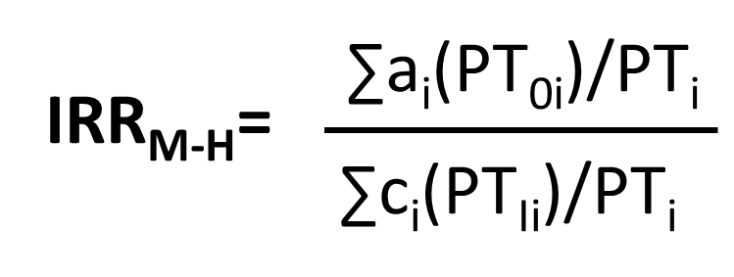
Age < 65
Age 65 +
Person-
Years
Person-
Years
Deaths
Deaths
Males
14
1516
Males
76
949
Females
10
1701
Females
121
2245
PT₁=3217
PT₂=3194
IRR(<65) = 1.57
IRR(65+) = 1.49
IRR_{M-H}=[14(1701)/3217]+ [76(2245)/3194]
[10(1516)/3217]+ [121(949)/3194]
=1.5
After adjusting for age category (<65 years, 65+), men had a 1.5 times higher mortality rate of Trigeminal Neuralgia-Related death than women.

Slide 48
Summary: Male Sex and Trigeminal Neuralgia-Related Death
?
Trigeminal neuralgia-related death
Male sex
⁻
⁺
Age
Adjusted estimate (IRR=1.5) was stronger than crude estimate (IRR=1.1)
Age confounded the true relationship between gender and trigeminal neuralgia-associated death
What is the direction of the confounding?

Slide 49
Interpretation (examples)
Longitudinal study (cohort or RCT)
After adjusting for [the confounder], the [risk] of [the health outcome] in those who were exposed was X times the [risk] of [the health outcome] in those who were unexposed.
Case-control study
After adjusting for [the confounder], the odds of the exposure among cases was X times the odds of exposure among controls.

Slide 50
Direction of confounding
Bias away from the null
Overestimation of the strength of the association
Crude measure is further from 1.0 than the adjusted measure
E.g. 3.0 vs. 1.0 (alcohol and lung cancer example)
0.25 vs. 0.5
Bias toward the null
Underestimation of the strength of the association
Crude measure is closer to 1.0 than the adjusted measure
E.g. 1.1 vs. 1.5 (gender and trigeminal neuralgia example)
0.9 vs. 0.8

Slide 51
Residual confounding
Residual confounding is the amount of confounding left after adjusting for one or more confounders
Unknown/unmeasured/mis-measured confounders
Failure to fully adjust for a confounder because of broad confounder categories
Age (old vs. young)
BMI (high vs. low)

